Slide 1

Logistic Regression
Reading: 9.1-9.4
7.3-7.6
exercises: Ch 9. 21,33,35,37
Assigned: none
Producer: dr. mario
img credit: alex riegert-waters

Slide 2
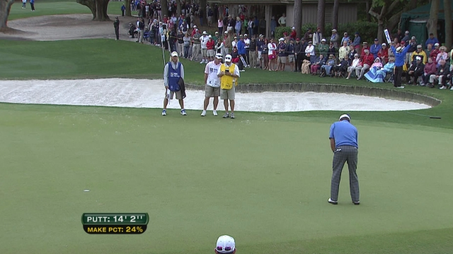
Motivation

Slide 3



Binary Logistic Regression Model
Response Variable is Binary (Coded as Indicator)
Predictor Variable Could Be Numeric or Categorical
Bad Idea -> Linear Regression or ANOVA
$$Y=\left\{\begin{aligned}1 if Yes (Success) \\ 0 if No (Failure)\end{aligned}\right.$$
$$Y≠β_{0}+β_{1}X+ε$$
$$Y≠μ+α_{i}+ε$$

Slide 4

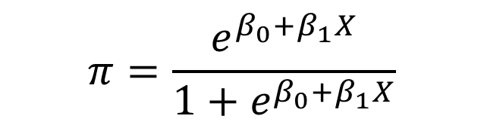
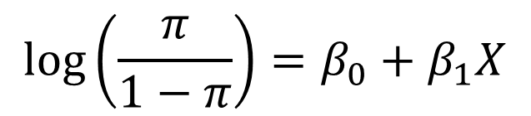

Binary Logistic Regression Model
Requirements
Logistic Regression Model
$$Y=Binary Response$$
$$X=Predictor Variable$$
$$π=P\left(Y=1 | X=x\right)=Proportion of 1^{′}s if X=x$$
$$\log\left(\frac{π}{1−π}\right)=β_{0}+β_{1}X$$
$$π=\frac{e^{β_{0}+β_{1}X}}{1+e^{β_{0}+β_{1}X}}$$
or
Linear Model

Slide 5


Binary Logistic Regression Model
Parameter $π$ Versus Statistic $p$
Example
$π$ = Probability of Having Green Eyes
Sample of 10 Random People
$p$ = Sample Average or Proportion of Blue-Eyed People in Sample
Another Reason Why Linear Regression or ANOVA Wouldn’t Work
$$0,1,1,0,1,0,0,0,0,0$$
$$p=\frac{0+1+1+0+1+0+0+0+0+0}{10}=\frac{3}{10}=0.3=30\%$$

Slide 6

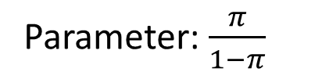
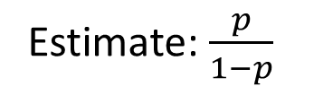
Binary Logistic Regression Model
Odds that $Y=1$
Odds are a Ratio of $P(Y=1)$ to $P\left(Y≠1\right)=P(Y=0)$ (Binary Case)
Example: The Odds of a Horse Winning a Race is 4 to 1 or 4:1 or 4
Interpretation: “4 Wins for Every 1 Loss”
Probability: $P\left(Win\right)=4/5$ and $P\left(Loss\right)=1/5$
Calculation of Odds: $P\left(Win\right)$/ $P\left(Loss\right)=\frac{4}{5}∗\frac{5}{1}=4$
Parameter: $\frac{π}{1−π}$
Estimate: $\frac{p}{1−p}$

Slide 7
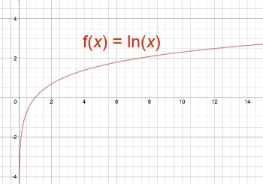

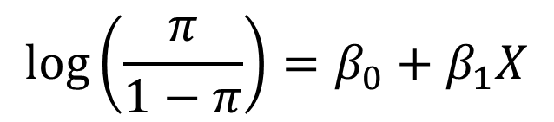
Binary Logistic Regression Model
Reason for Logistic Regression Model
Notice
Probability: $0<π<1$
Odds: $0<\frac{π}{1−π}< ∞$
Log Odds: $−∞<\log\left(\frac{π}{1−π}\right)< ∞$
$$\log\left(\frac{π}{1−π}\right)=β_{0}+β_{1}X$$
img credit: study.com

Slide 8
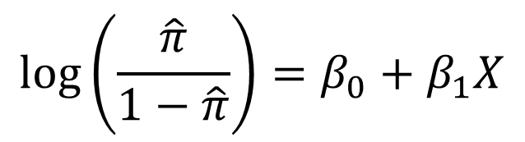
Binary Logistic Regression Model
Interpretation of Logistic Regression Model
Model:
Default in Statistics is the Natural Logarithm
Intercept Represents the Log Odds When X=0
Slope Represents the Change in Log Odds When X Increases by 1
$$\log\left(\frac{\hat{π}}{1−\hat{π}}\right)=β_{0}+β_{1}X$$

Slide 9
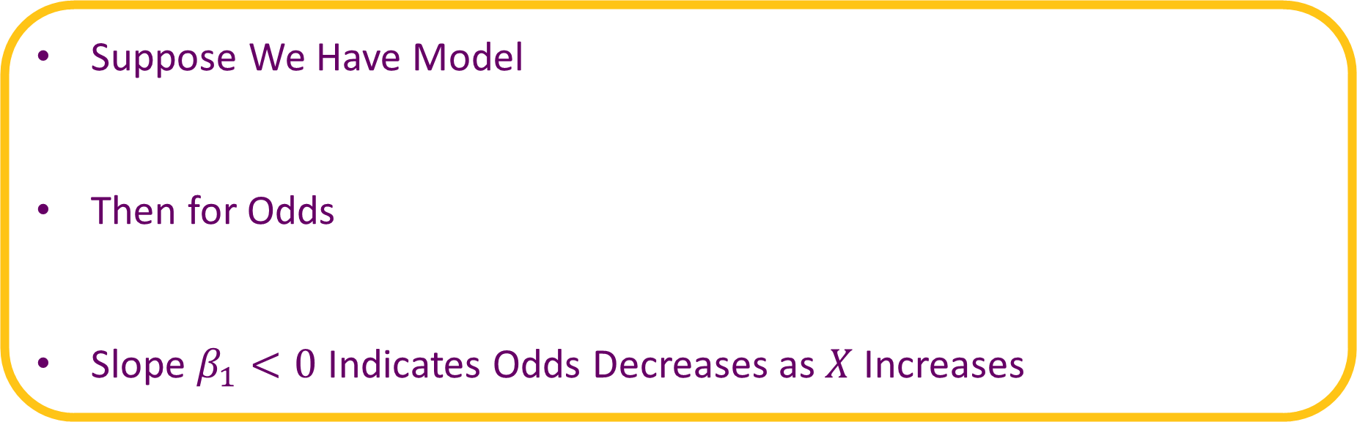
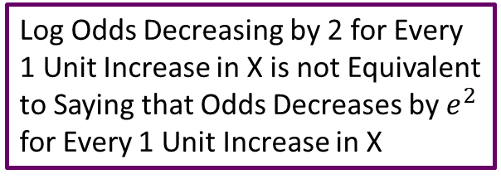

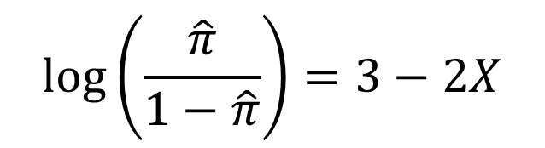
Binary Logistic Regression Model
Suppose We Have Model
Then for Odds
Slope $β_{1}<0$ Indicates Odds Decreases as $X$ Increases
$$\log\left(\frac{\hat{π}}{1−\hat{π}}\right)=3−2X$$
Log Odds Decreasing by 2 for Every 1 Unit Increase in X is not Equivalent to Saying that Odds Decreases by $e^{2}$ for Every 1 Unit Increase in X
$$\frac{\hat{π}}{1−\hat{π}}=e^{3−2X}≠e^{3}−e^{2}X$$

Slide 10

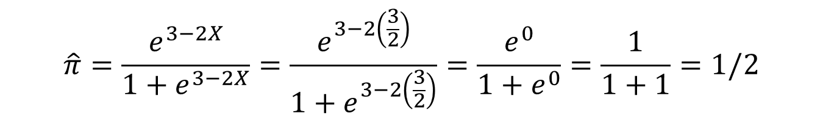
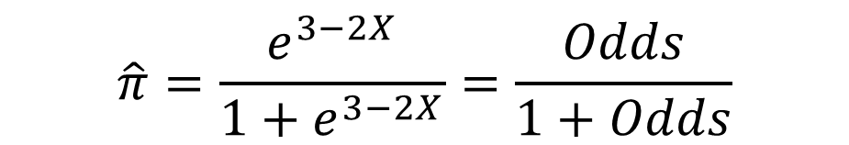
Binary Logistic Regression Model
Suppose We Have Model
Then for Probability
Notice What Happens When $X=\frac{{−β}_{0}}{β_{1}}=\frac{3}{2}$
$$\log\left(\frac{\hat{π}}{1−\hat{π}}\right)=3−2X$$
$$\hat{π}=\frac{e^{3−2X}}{1+e^{3−2X}}=\frac{Odds}{1+Odds}$$
$$\hat{π}=\frac{e^{3−2X}}{1+e^{3−2X}}=\frac{e^{3−2\left(\frac{3}{2}\right)}}{1+e^{3−2\left(\frac{3}{2}\right)}}=\frac{e^{0}}{1+e^{0}}=\frac{1}{1+1}=1/2$$

Slide 11

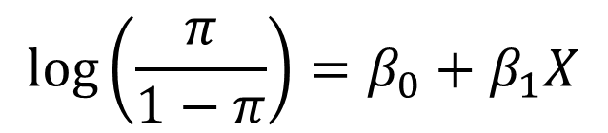
Binary Logistic Regression Model
Estimating Parameters $β_{0}$ and $β_{1}$
Recall in Linear Regression We Chose Estimates Based Off Minimization of a Bad Thing (SSE)
In Logistic Regression We Choose Estimates that Maximize the Likelihood (Good Thing)
The Likelihood the Probability of Our Data
$$\log\left(\frac{π}{1−π}\right)=β_{0}+β_{1}X$$

Slide 12


Binary Logistic Regression Model
Function in R that Estimates Logistic Regression Models
GLM Stands for Generalized Linear Model
The “family=binomial” Argument Uses a Logit Link Function to Connect the Mean $π$ to a Linear Predictor
glm(formula, family=binomial, data)
$$logit\left(π\right)=\log\left(\frac{π}{1−π}\right)$$

Slide 13
Example: Putts
Data from 587 Different Putts
Question: What is the relationship between the length of a putt and the probability of making that putt?
Length | 3 | 4 | 5 | 6 | 7
Made | 84 | 88 | 61 | 61 | 44
Missed | 17 | 31 | 47 | 64 | 90
Total | 101 | 119 | 108 | 125 | 134

Slide 14
Supplement for Lecture 27
Plot Raw Data and Fit Linear Regression -> Problematic
Plot Summarized Data and Fit Linear Regression -> Problematic
Fit Logistic Regression and Redo Plots -> Reasonable

Slide 15
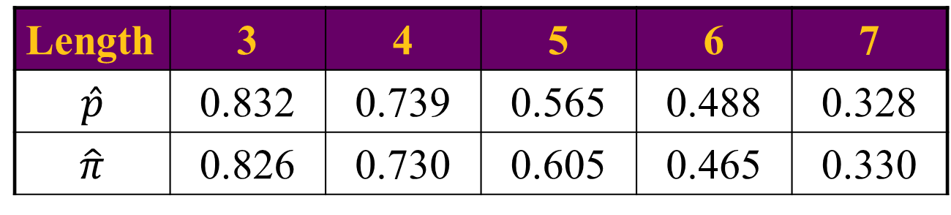

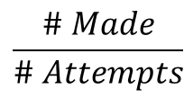
Supplement for Lecture 27
Comparing Sample Proportions to Estimates From Model
Estimate Odds
When are the Odds Greater Than 1?
When are the Odds Less Than 1?
$$\frac{\# Made}{\# Attempts}$$
Length | 3 | 4 | 5 | 6 | 7
$$\hat{p}$$ | 0.832 | 0.739 | 0.565 | 0.488 | 0.328
$$\hat{π}$$ | 0.826 | 0.730 | 0.605 | 0.465 | 0.330
Why the Difference?
$$\frac{e^{3.26−0.57X}}{1+e^{3.26−0.57X}}$$

Slide 16
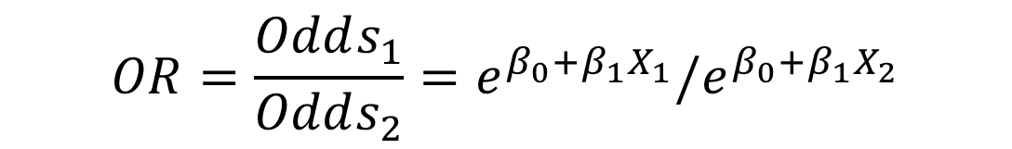
Odds Ratios
Way to Compare Two Groups
Example: Compare a Putt at 3ft Versus a Putt at 4ft
Formula
Interpretation: Odds of success in Group 1 is ____ times the odds of success in Group 2
$$OR=\frac{Odds_{1}}{Odds_{2}}=e^{β_{0}+β_{1}X_{1}}/e^{β_{0}+β_{1}X_{2}}$$

Slide 17

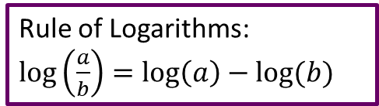
Supplement for Lecture 27
Calculate Odds Ratios
Compare Odds Ratios to Slope of Logistic Regression Model
What Happens When We Increase X by 1?
$$Slope=\frac{Rise}{Run}=\frac{Change in Log Odds }{1−0}=\frac{\log\left(Odds_{a+1}\right)−log⁡(Odds_{a})}{1−0}=log⁡(OR)$$
Rule of Logarithms: $\log\left(\frac{a}{b}\right)=\log\left(a\right)−log⁡(b)$
$$e^{β_{0}+β_{1}(X+1)}=e^{β_{0}+β_{1}X+β_{1}}={(e^{β_{1}})e}^{β_{0}+β_{1}X}$$
Rule of Exponents: $x^{a+b}=x^{a}x^{b}$
Odds
Odds

Slide 18
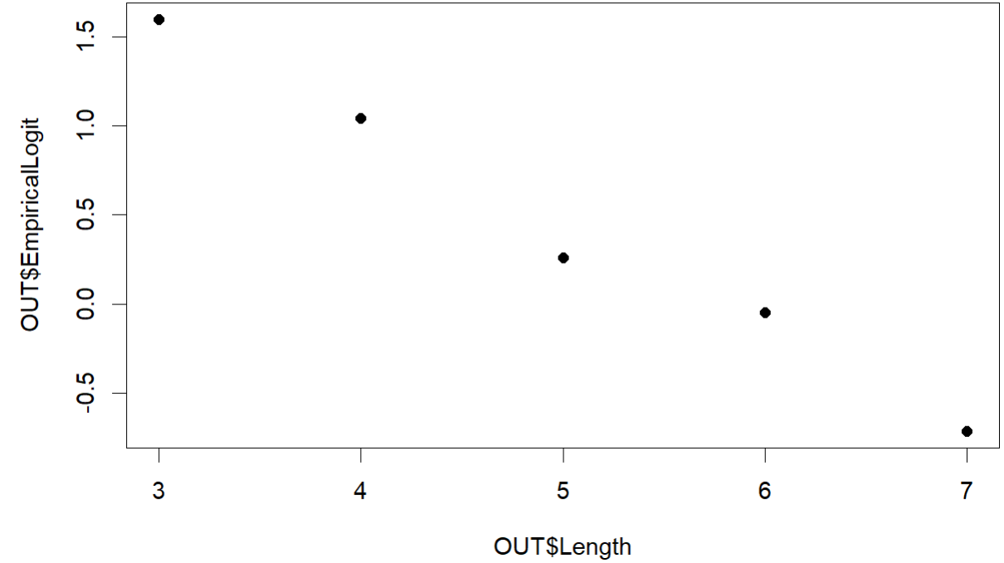
Assumptions for Logistic Regression
Linearity
Assume the Linear Model for the Log Odds is Reasonable
Assess by Plotting the Log Odds from Proportions in Sample Against Your X Variable
Check for Linearity
Large Sample Size
Recall: np>10 and n(1-p)>10
Require 10 Successes and Failures Per Predictor Variable

Slide 19
Assumptions for Logistic Regression
Randomness
Is Flipping a Weighted Coin Reasonable for Deciding Whether or Not the Outcome is 0 or 1?
Tied to the Bernouilli Distribution (Binary Variables)
Independence
Observed Successes/Failures Independent of Each Other
Tied to the Binomial Distribution
No Multicollinearity (Applies if Doing Multiple Logistic Regression)

Slide 20

Hypothesis Test and CI for Slope
Hypotheses
$H_{0}:β_{1}=0$
$H_{a}:β_{1}≠0$
Test Statistic
$z^{∗}=\frac{{\hat{β}}_{1}}{SE_{{\hat{β}}_{1}}}$
P-Value
Use Standard Normal Distribution
Use 2*(1-pnorm(abs(zstar),mean=0,sd=1)) Function in R

Slide 21

Hypothesis Test and CI for Slope
Decision – Same As Always
Interpret – Similar to Interpretation of Test from SLR
Alternative: Confidence Interval
${\hat{β}}_{1}±1.96∗SE_{{\hat{β}}_{1}}$
Does it Contain 0? Yes or No?
CI for Odds Ratio – Exponentiate Both Bounds of CI

Slide 22
Likelihood Ratio Test
Tests Overall Effectiveness of the Model
Hypothesis Test for Comparing Empty Model to Full Model
Similar to F-test in Linear Regression
Almost Equivalent to Previous Hypothesis Test (P-values Similar)
Let L Represent the Likelihood of our Model – We Want to Maximize

Slide 23

Likelihood Ratio Test
The glm() Function Minimizes $−2∗log⁡(L)$ (Same as Maximizing L)
The glm() Function also Estimates L₀ Which is the Likelihood of the Constant Model or Empty Model (Only an Intercept)
Effectiveness of Model Can Be Measured by the Test Statistic
$G^{∗}=−2∗\log\left(L_{0}\right)−\left(−2∗\log\left(L\right)\right)$
Notice: $G^{∗}=−2\left(\log\left(L_{0}\right)−\log\left(L\right)\right)=−2∗\log\left(\frac{L_{0}}{L}\right)$

Slide 24

Likelihood Ratio Test
P-value
Use Chi-Squared Distribution
Degrees of Freedom for Chi-Squared is 1 When Full Model has 1 Predictor
Hypotheses the Same as Previous Test
$H_{0}:β_{1}=0$
$H_{a}:β_{1}≠0$
Testing Same Hypothesis Test but Trust LRT Over Previous Test

Slide 25
Supplement for Lecture 27
Examine Output from Logistic Regression
Get Confidence Intervals for Slope
Get Confidence Intervals for Odds Ratio
Perform Likelihood Ratio Test

Slide 26
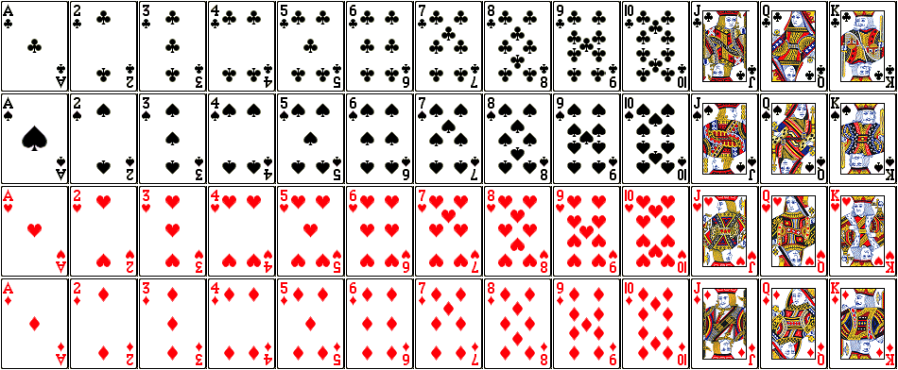
Maximizing Likelihood
Suppose There are Three Decks of Playing Cards
Standard 52 Card Deck
Euchre Deck (9,10,J,Q,K)
Only Red Cards from the Deck (26 Cards)

Slide 27

Maximizing Likelihood
Sample 2 Cards: Get Jack of Hearts and then the Jack of Diamonds
Let L Represent the Likelihood of Our Sample
Probability of the Sample Under All Three Situations
Full Deck: $L=\left(\frac{1}{52}\right)∗\left(\frac{1}{51}\right)≈0.00038$
Euchre Deck: $L=\left(\frac{1}{24}\right)∗\left(\frac{1}{23}\right)≈0.0018$
Red Deck: $L=\left(\frac{1}{26}\right)∗\left(\frac{1}{25}\right)≈0.0015$
← Most Likely

Slide 28
Thank You
Make Reasonable Decisions

